Slide 1

Price and availability analysis on Rental properties in hyderabad

Slide 2

Presented by:
Kajal Daga
B.Tech Electronics & Communications Engineering
Currently working as a Quality Team lead at TechM
LinkedIN - NA
Github - NA
Amit Mazumdar
B.Tech Mechanical/Automobile Engineering
Currently working as a Project Coordinator lead at TechM
LinkedIN - NA
Github - NA

Slide 3

Business Problem
To get a better picture of the available and cost of the rented properties in different locations of hyderabad using Makaan.com as source of the Property Details.

Slide 4

Objective of the project
Price and availability analysis on rental properties in hyderabad using Makaan.com as source of the Property
It will help users where they can rent the property as per the requirements

Slide 5
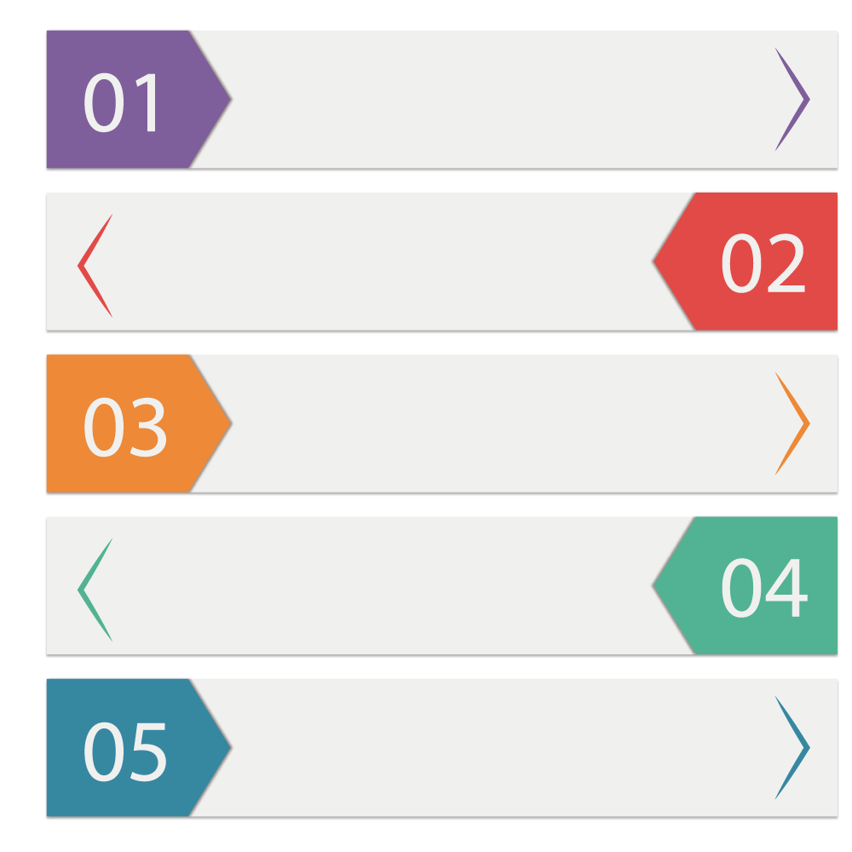

Steps followed to Collect the data
Used makaan.com to check and collect the property listings
Used the URL of the website to get the data using request module in python
Used python module BeautifulSoup to convert the extracted data into understandable data.
Using inspect on the webpage took the details of the containers.
Used re module to extract the data in required format, created a structured data and saved in a file.

Slide 6

Summary of the collected data
Room_capacity - Holds the number of rooms
Layout - BHK, RK
Property_type - Apartment, Villa, Independent, Studio, Penthouse
Location - location of the property in the city
City - Name of the city where properties a listed
Price - Rental price of each property
Area_in_sqft - Total area covered by each property in sq.ft
Status - Furnished, Semi-Furnished or Unfurnished
No_bathrooms - No. of bathrooms in each individual properties
Facing - Property facing direction(vastu)
Room_layout - No. of BHKs, RKs of each listing

Slide 7

Exploratory Data Analysis:

Slide 8


Data Cleaning and Manipulation Steps
Removed the data which is not relevant to gain the objective
Fixed structural errors, Changed data types.
Dealt with missing data by using fillna, bfill, ffill etc when required
Validated and saved the cleaned and useful data for further steps.

Slide 9

Data Analysis

Slide 10
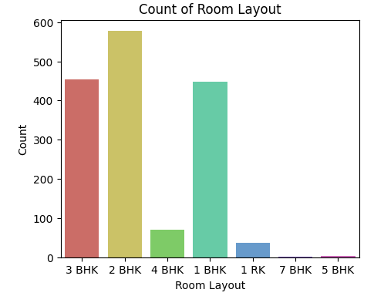
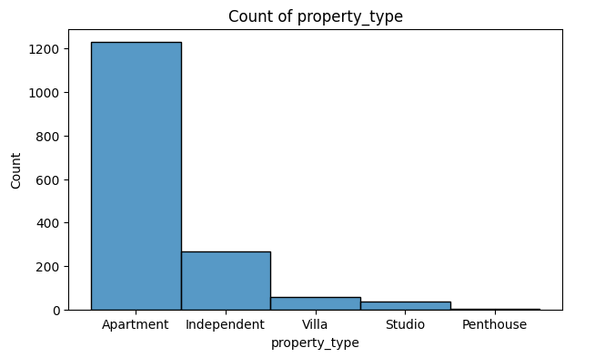
Property Analysis - Type & BHK
577
1229
454
71
447
3
265
57
36
36
1
2
Highest availability - 2BHK & Lowest availability - 7 BHK
Property owners mostly prefer 1,2,3 BHK for rent
Apartments are high in availability for rent.

Slide 11
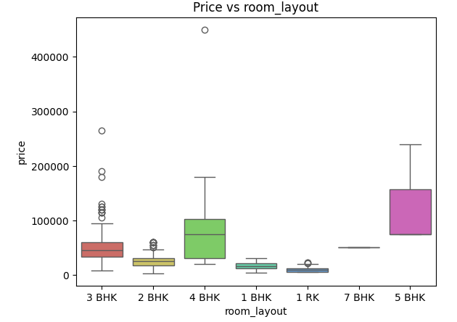
Property Analysis - for checking properties with extreme rent price based on layout
As per the boxplot, there are 10 - 3 bhk properties which are listed with a higher price.
We have 4 properties in 2BHK which are listed with extreme high price
Also we have 1RK which is listed at a higher price

Slide 12
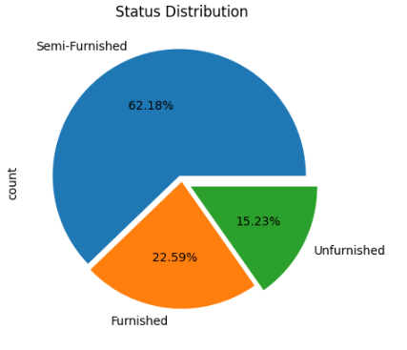
Property Analysis - to check the distribution of Furnished, unfurnished and Semi furnished properties
In conclusion most of the properties in Hyderabad are Semi Furnished.

Slide 13
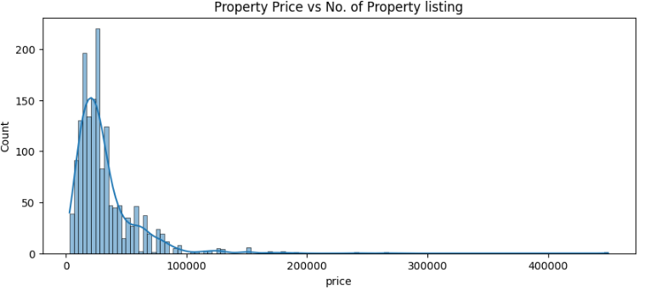
In the listed properties most of the properties are priced under 1 lakh from which more than 200 properties are listed at around 50 thousand price point.

Slide 14
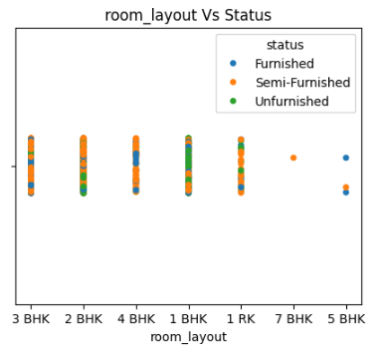
Property Analysis - to check
In Conclusion most of the 2, 3, 4 BHK properties are Semi Furnished including 1 RK.

Slide 15
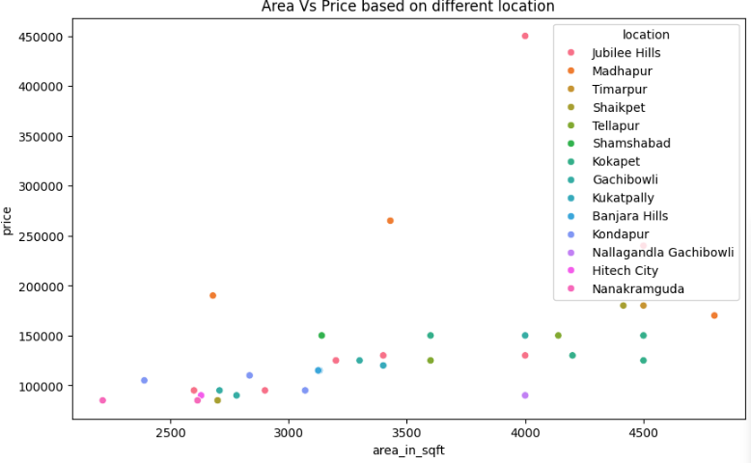
Price and Area has a positive relation as price increases with Area.

Slide 16
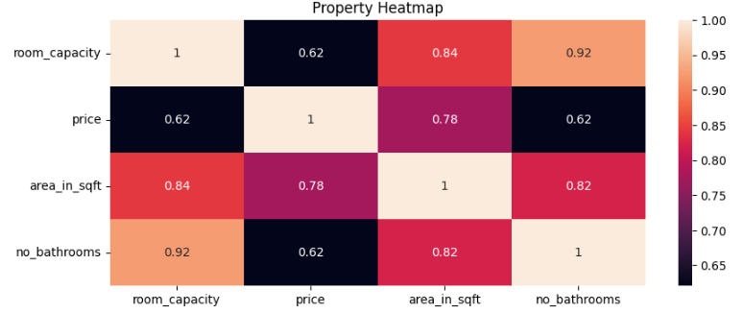
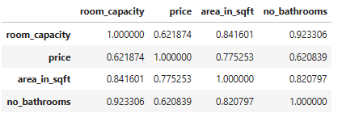
By looking at the heatmap we can clearly conclude that the relationship between Price and Room Capacity, Area-sqft is Strongly Positive which means price increases with the room capacity and Area of a property.

Slide 17
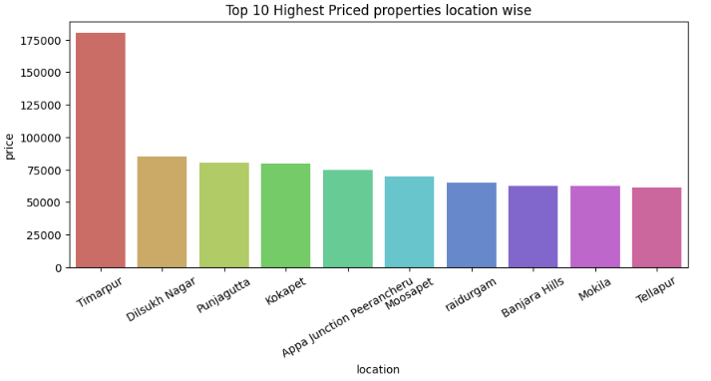
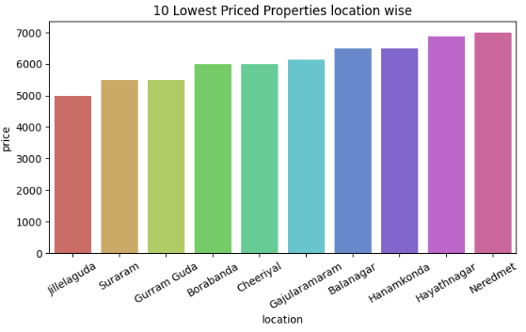
Properties in the Timarpur area are costly compare to all other locations.
Properties in the jillelaguda area are less cost compare to all other locations

Slide 18

Conclusion:
The factors affecting the Price of the properties increases with the
Area
Number of room capacity (bhk)
Furnished vs Semi/Unfurnished
Location
Most of the available property in hyderabad are in Apartments which are mostly 2BHK and 3BHK with semi Furnished

Slide 19

Challenges :
While collecting the data from the website. The data in the containers were in different formats
Price units are not in the same format i.e few were in lakhs and few in thousands

Slide 20

Q&A

Slide 21


